Slide 1
analytics to identify digital Opioid access
BY
Shubham Goswami
Sujin Park
Vigneshwaran Giri Velumani

Slide 2

OBJECTIVE
Develop a solution to identify and classify Illicit Online Marketing, Sales and consumption of Controlled Substances (Opioids) using Instagram
2

Slide 3
EXPLORATORY ANALYSES
It is estimated that 90 Americans die daily by overdosing on opioids, a staggering figure highlighting the human toll of this public health crisis that continues to escalate
The United States is in the midst of a devastating opioid misuse epidemic leading to over 33,000 deaths per year from both prescription and illegal opioids
Roughly half of these deaths are attributable to prescription opioids
Federal and state governments have only recently begun to grasp the magnitude of this public health crisis
Other federal agencies involved with the federal regulatory effort include the Food and Drug Administration (FDA), the Drug Enforcement Agency (DEA), and the Department of Justice
Instagram is the one of the largest social networking service having 1 billion Monthly Active Users and 500 million daily active users
Over 100 million photos are uploaded every day and has 2 million monthly advertisers
3
Notes:
References:
https://www.ncbi.nlm.nih.gov/pubmed/29049113
https://sproutsocial.com/insights/instagram-stats/
https://blog.hootsuite.com/instagram-statistics/

Slide 4
METHODOLOGY
Phantombuster API was used to extract the Instagram posts
The postUrl was used to extract the comments of the respective posts
The data cleaning and preprocessing followed by Data stemming
Further, bag of words approach was used to filter relevant Text (posts & comments) from the non-relevant Text (Screening step)
Manually trained the relevant Texts to build a training dataset for Google Auto ML
Using Google Auto ML Classification, the relevant texts were classified into 5 buckets –
Selling
Consumers
Experience sharing
News/awareness
Others
4
Notes:
References:
https://phantombuster.com/

Slide 5
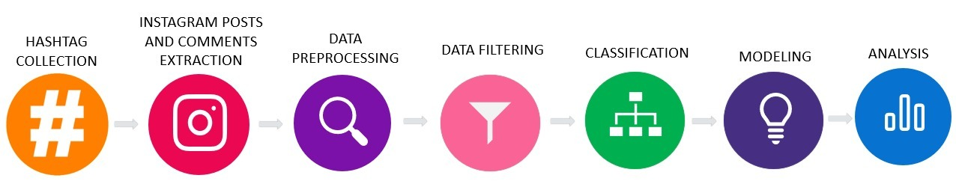
PROCESS CHART
Collecting relevant hashtags for
data extraction
Using PhantomBuster API
Removing undesired punctuations, stop words, and
Stemming
Matching the stemmed text with stemmed bag of words
Manually Classifying Texts into 5 buckets
Training Google Auto ML
Finding the actual sellers and consumers

Slide 6
PROCESS FLOW
Hashtag Collection & Extracting Posts & Comments from Instagram:
Collected 57 opioid drug names and their relevant keywords
Used Phantombuster’s Instagram Hashtag Collector API and extracted 104014 posts
Used the ‘profileUrl’ of the posts and extracted 79356 comments
Combined Texts (Posts & Comments) were 170861
Date range of the posts were from 2015-2019
Data Pre-processing
Removed Duplicates and left with 166401 observations
Used Regular Expression to process the Text - removed emojis, Unicode characters, stop words, whitespaces, extra newlines and all punctuations
Performed Tokenization to break down text as unigram tokens
Data Stemming
Performed stemming to map the words in the Text with the bag of words that contains the seller, consumer and awareness related keywords
SnowballC, plyr, sos, laply and stringr packages for using Corpus function to stem the data
6

Slide 7
PROCESS FLOW
Data Filtering (Screening):
Created a function that gets two inputs (1) Stemmed Text and (2) stemmed bag of words list
Texts were matched with bag of words and based on that scores were assigned; if the value is more than 0 then the Text was classified as relevant category (Seller, Consumer, Awareness) and classified as others when score was 0
Total observation with class was 151288
Removed “Others” labels and left with 47112 Observations
Classification of Text ( Posts & Comments) and Modeling:
Trained Google AutoML model using manually classified data (actual Text -after mapping the relevant text with the actual Text)
Classified 3747 Observations manually (Training Data) into 5 buckets
Selling - 116
Consumers - 252
Experience Sharing - 126
News/awareness – 150
Others – 3103
7

Slide 8
PROCESS FLOW
Analysis:
Manually identified and differentiated Marijuana Text from Opioid in Sellers and Consumers Buckets
Created Sub-categories in both Sellers and Consumers Buckets under Marijuana & Opioid classifications
Manually identified profileURLs and used Phantombuster’s Instagram Profile Scraper API to extract users profile data
Analyzed Sellers and identified their website/links, email ids & contact numbers
Analyzed Consumers characteristics
8

Slide 9


DATA GATHERING
Hash Tags Collection
Comments Extraction
Posts Extraction
Hash Tags Collection
HashTags
#opioid
#oxycontin40mg
#oxycondone
#oxycontins
#vicodinhigh
#promethazineandcodeine
#percsfordays
#percs
#drinkinglean
#morphine
#methadone
#hydrocodone
#fentanyl
#tramadol
Listed opioid-related hash tag
Total 57 hashtags were collected
Example of hashtags

Slide 10
DATA GATHERING
Posts Extraction
Utilized Phantombuster’s Instagram Hashtag Collector API to extract the recent posts for the listed hashtags
Total 104,014 posts were collected with postUrl, likeCount, commentCount, and so forth
Comment Extraction
Used Phantombuster’s Instagram Auto Commentor API to extract the comment of collected Instagram posts
Total 79,356 comments were collected with postUrl, likeCount, userName and so forth
Posts
Columns | Description
query | Hashtag that lead to the post
likeCount | Number of likes the post received
commentCount | Number of comments the post received
ownerId | Instagram unique ID of post author
profileUrl | Profile URL of post author
profileName | Username of post author (only if available)
description | Post description
postUrl | Instagram post URL
imgUrl | Link to raw post image (if available)
pubDate | Post publication date
Location | Where the photo was taken (only if available)
postVideo | Link to raw video file (if available)
videoThumbnail | Link to raw video thumbnail (if available)
Views | Number of views, if the post contains a video
postId | Instagram ID of the post
Comments
Columns | Description
Username | The name of the user
query | URL of the post
comment | Comment
likeCount | The number of likes on the comment
commentDate | The date of the comment
profileUrl | URL of the user’s account
postID | Name of the user
ownerId | Instagram ID of the comment user
profilePictureURL | URL of the post’s picture
timestamp | The date of the comment

Slide 11
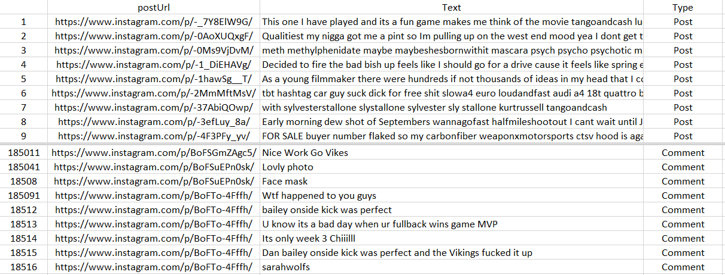
DATA GATHERING
Sample Dataset

Slide 12

DATA PRE-PROCESSING
Remove the punctuation marks
Stemming
Transform to lowercases
Remove stopwords
Original Text
**This week special** BUY one GET one free. UDT tablet contains tramadol Hcl, which is a narcotic-like pain reliever. Ultram is used to treat moderate to severe pain for knee pain relief, and constipation pain relief..... Visit Tramadolshop.is to Grab the deal Now!#deal #discount #painkiller #pain #medicine #onlinepharmacy #medatyourdoor #medicinediscount #pharmacy #painreleif #painkillers #painrelief #buyonegetonefree #healthcare #healthcaresolution
Transform to lowercases
**this week special** buy one get one free. udt tablet contains tramadol hcl, which is a narcotic-like pain reliever. ultram is used to treat moderate to severe pain for knee pain relief, and constipation pain relief..... visit tramadolshop.is to grab the deal now!#deal #discount #painkiller #pain #medicine #onlinepharmacy #medatyourdoor #medicinediscount #pharmacy #painreleif #painkillers #painrelief #buyonegetonefree #healthcare #healthcaresolution
Remove the punctuation marks
this week special buy one get one free udt tablet contains tramadol hcl which is a narcotic like pain reliever ultram is used to treat moderate to severe pain for knee pain relief and constipation pain relief visit tramadolshopis to grab the deal now deal discount painkiller pain medicine onlinepharmacy medatyourdoor medicinediscount pharmacy painreleif painkillers painrelief buyonegetonefree healthcare healthcaresolution
Remove stopwords
week special buy one get one free udt tablet contains tramadol hcl narcotic like pain reliever ultram used treat moderate severe pain knee pain relief constipation pain relief visit tramadolshopis grab deal now deal discount painkiller pain medicine onlinepharmacy medatyourdoor medicinediscount pharmacy painreleif painkillers painrelief buyonegetonefree healthcare healthcaresolution
Stemming (snowball)
week special buy one get one free udt tablet contain tramadol hcl narcot like pain reliev ultram use treat moder sever pain knee pain relief constip pain relief visit tramadolshopi grab deal now deal discount painkil pain medicin onlinepharmaci medatyourdoor medicinediscount pharmaci painreleif painkil painrelief buyonegetonefre healthcar healthcaresolut

Slide 13

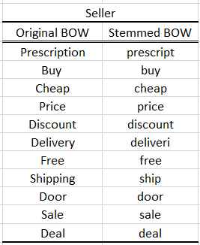
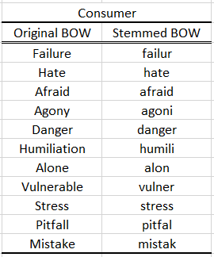
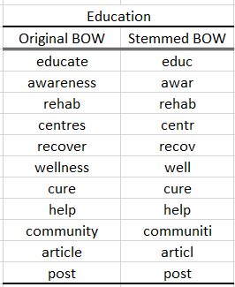
DATA FILTERING
Stemming for Bag of words
Scoring
Bag of Words
Bag of words for each bucket were collected based on literature review
All bag of words were stemmed for comparison with the stemmed text
BOW: 68
BOW: 27
BOW: 70

Slide 14
DATA FILTERING USING SCORES
Text | Edu_awar_Score | Seller_Score | Consumer_Score | type
getyourmed descret ship avail wickrkik hoodplug99 text 0 8691339 whatsapp 1440 9413147 place order qualiti medic xanax adderal lsd mdma lean coke ice cb method opiat shroom xtc oxi molli ketamin perc roxi amp | 1 | 5 | 0 | Seller
buy medicin can pain moreov buy medicin can often burn hole pocket good news tramadolshopi give platform buy medicin onlin also help save consider amount money hurri bogo offer valid day reason buy medicin tramadolshop authent medicin lowest price intern trust pharmaci conveni simpl process great discount offer contact us https tramadolshopi mail us direct tramadolshopneomailboxch bestpharmaci pharmaci usa usapharmaci happycustom onlinepharmaci | 3 | 13 | 1 | Seller
gambl addict fall group addict physiolog damag psycholog financi environment mean well substanc like herion cocain alcohol prescript painkil caus physiolog depend subsequ withdraw brought abstin depend withdraw typic includ headach shake extrem anxieti nausea physic pain among mani symptom substanc also caus psycholog financi environment damag given sure physiolog addict substanc must wors well matter opinion debat evid sever physic withdraw correl difficulti free oneself addict smoke exampl littl physic withdraw million feel like can t stop even though crippl expens proven lethal us soldier vietnam war show physic depend morphin relat drug administ reliev pain bare relev 90 physic depend ceas use drug immedi upon arriv home compar averag 9 total heroin user ever ceas use show opinion place much weight physic depend trivialis addict gambl social media shop can just devast caus bankruptci anxieti depress breakdown key relationship gambl still advertis readili given devast can caus find shock think addict far psycholog matter right coach therapi support can conquer irrelev physic depend feel like lose control someth whatev start addict ignor wealth support onlin pleas give call 07789636873 free chat free help mentalhealth drink stopdrink lifestyl health heal hypnosi hypnotherapi nlp coach mind | 4 | 5 | 17 | Consumer
addict look like know mani us fell culprit pain killer began true issu pain injuri went famili doctor order xray mris sent us home pain pill muscl relax everi 34 year grow toler medicin need dosag increas develop depress pain chain now oh now rx valium xanax ect fast forward 10 year later dose pain killer strong enough knock hors due toler built now physic mental depend pain killer nerv pill end usual never peopl ride roller coaster pain depress anxieti pill rest life tell cri day longer depend pill fire pain doctor sever month without medic swore still swear hurt take research also prove caus pain seek altern method tri let know otherwis pleas dont judg assum person fine look like upstand citizen cours blend may pharmacist lawyer even neighbor bodi scream agoni although began journey just seek legal relief follow medic advic physic mental hook bodi cant function without opioid liter cri help embarrass fact idea ever live without pain pill dare tell anyon grown addict tell doctor pretti sure addict way cut us can function without medic end career due file addict horror stori peopl live daili share help may everyon might save someon | 9 | 6 | 20 | Consumer
fbi agentsarrestedform insi therapeuticsinsi 95ceo michael babich five former compani execut thursday alleg bribe doctor prescrib extrem addict opioid painkil patient didn t need indict span babich former insi vp sale alec burlakoff former nation director sale richard simon number sale manag market execut depart justic doj alleg execut took part nationwid conspiraci give healthcar provid kickback exchang improp prescrib subsi opioid medic contain high addict substanc fentanyl consid even danger painkil like vicodin alleg top execut insi therapeut inc paid kickback commit fraud sell high potent addict opioid can lead abus life threaten respiratori depress said harold shaw special agent charg fbi s boston field divis statement contribut grow opioid epidem place profit patient safeti cannabi cannabinoid psylocibin oxycodon oxi burningman coachella edc marchmad drug drugdeal lawenforc opiodepidem parti funtim liveforthemo livelaughlov sex america | 10 | 7 | 4 | Educ_awar
opioid abus one lead caus death new mother colorado s local hospit offer someth new csection patient altern opioid new mom lauren becko happi learn option denver mom deliv babi abigail four week ago csection swedish medic center afterward chose use opioid pain manag instead dr juli gelman place small cathet muscl near incis continu releas numb medicin onq infus pain pump larg bulb medicin can carri around last 3 5 day along tylenol ibuprofen lauren need handl pain pregnant mom start opioid use addict problem long term problem tri reduc cut back opioid use can also reduc nausea vomit constip new mom rather focus babi awar awarenessisfreedom humanright csection csectionmom overdoseawar overdos opioidcrisi addict addict painkil postpartum postpartumbodi midwiferi midwif doula obgyn motherhood newmom birthmatt newborn postpartumfit csectionrecoveri csectionmama | 12 | 6 | 6 | Educ_awar
14

Slide 15
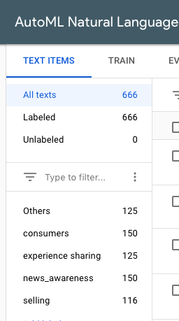
GOOGLE AUTO ML
Preparing the data:
Manually classified 3747 texts across 5 labels
Data used for training the model (666 texts):
Selling (116 texts)
Consumers (150 texts)
Experience Sharing (125 texts)
News and Awareness (150 texts)
Others (125 texts)
15

Slide 16
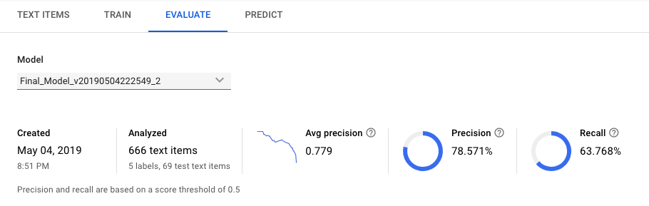
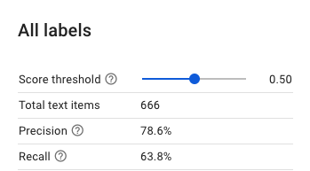
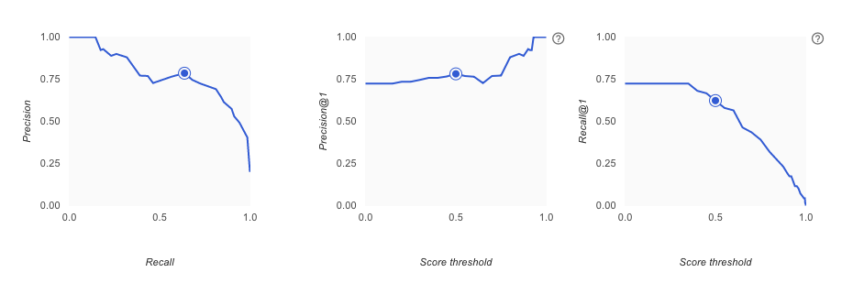
MODEL RESULTS
16

Slide 17
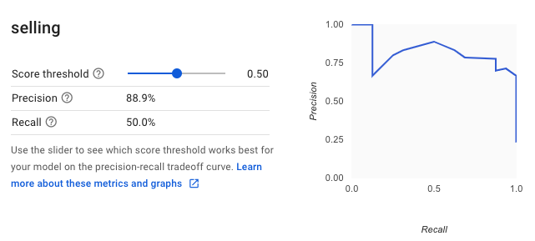
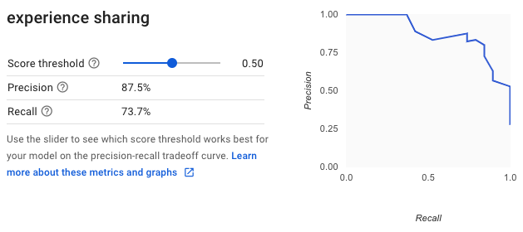
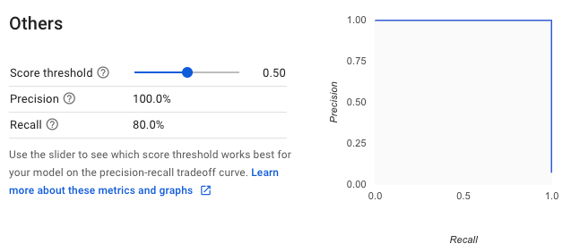
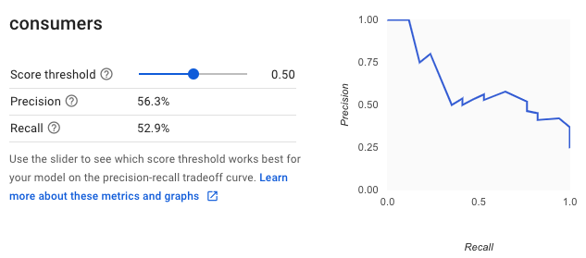
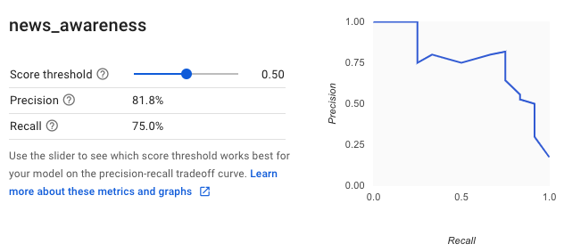
INDIVIDUAL LABEL RESULTS
17

Slide 18
EXTRACTING USER DETAILS OF EACH CATEGORY
Manually extracted profileURLs from postURLs
Used profileURL in Phantombuster’s Instagram Profile Scraper API to extract the profile details of all Instagram users in each category
The data extracted from the API includes:
Columns | Description
profileUrl | Instagram profile URL
imageUrl | Profile picture URL
profileName | Instagram username
instagramID | Instagram unique ID
fullName | Full name of the person
postsCount | How many publications they made
followersCount | How many followers they have
followingCount | How many accounts they follow
bio
website
verified | If Instagram has confirmed it's an authentic account
inCommon | If some of your Instagram friends follow that account
private | If the account is private
status | If you follow or have blocked that account
18
Notes:
References:
https://phantombuster.com/

Slide 19
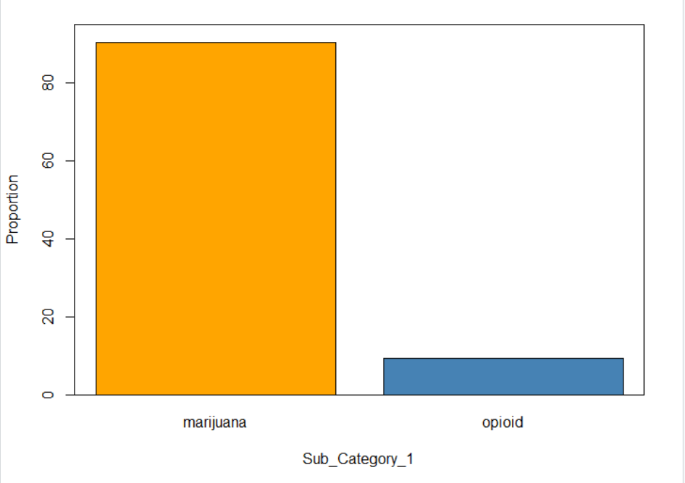
SUBCLASSIFICATION OF SELLING POSTS
Manually classified 116 Selling posts into 2 subcategories
Marijuana
Cbdoil
Glasspipes
Grower
Manufacturer
Smokeshop
Vapecart
weed
Opioid
Methylphenidate
Promethazinecodeine
Tramadol
multiple
19

Slide 20
CLASSIFICATION OF SELLING POST EXAMPLE
Original Text | Stemmed Text | Label | Sub_Category_1 | Sub_Category_2 | Website_link/Number
Getyourmedications descrete shipping available Wickrkik hoodplug99 Text 0 8691339 Whatsapp 1440 9413147 place your order for quality medications xanax adderall LSD MDMA lean coke ice cb method opiates shrooms xtc oxy Molly ketamine percs roxy amp more | getyourmed descret ship avail wickrkik hoodplug99 text 0 8691339 whatsapp 1440 9413147 place order qualiti medic xanax adderal lsd mdma lean coke ice cb method opiat shroom xtc oxi molli ketamin perc roxi amp | Selling | Opioid | Muliple | Text 0 8691339 Whatsapp 1440 9413147
buying medicines can be a pain Moreover buying medicines can often burn a hole in our pocket The good news is that Tramadolshopis giving you the platform to buy medicines online and also help you to save a considerable amount of money Hurry bogo Offer is valid for only few days Here are reasons why you should buy all your medicines from TRAMADOLSHOP Authentic medicines Lowest prices International Trusted pharmacy Convenient and simple process Great discounts and offers Contact us https tramadolshopis or mail us directly at TramadolshopNeomailboxCh bestpharmacy pharmacy usa usapharmacy happycustomers onlinepharmacy | buy medicin can pain moreov buy medicin can often burn hole pocket good news tramadolshopi give platform buy medicin onlin also help save consider amount money hurri bogo offer valid day reason buy medicin tramadolshop authent medicin lowest price intern trust pharmaci conveni simpl process great discount offer contact us https tramadolshopi mail us direct tramadolshopneomailboxch bestpharmaci pharmaci usa usapharmaci happycustom onlinepharmaci | Selling | Opioid | Muliple | http://tramadolshop.is/
20

Slide 21
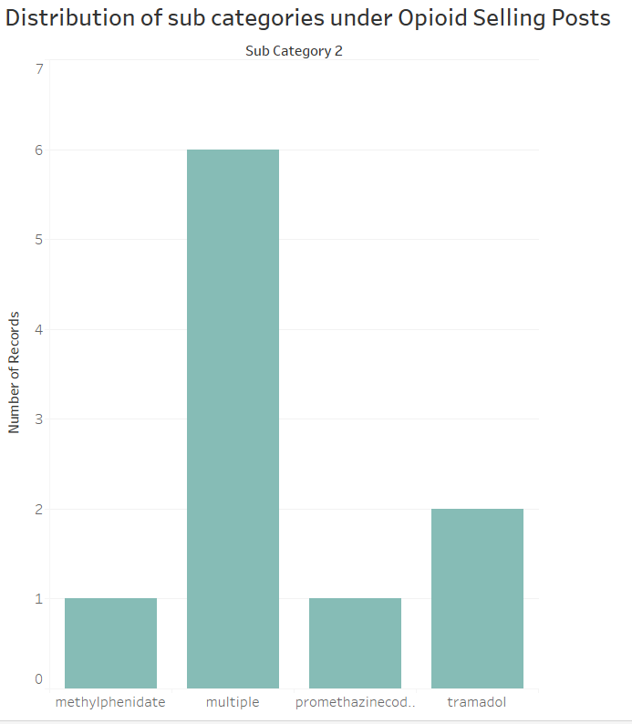
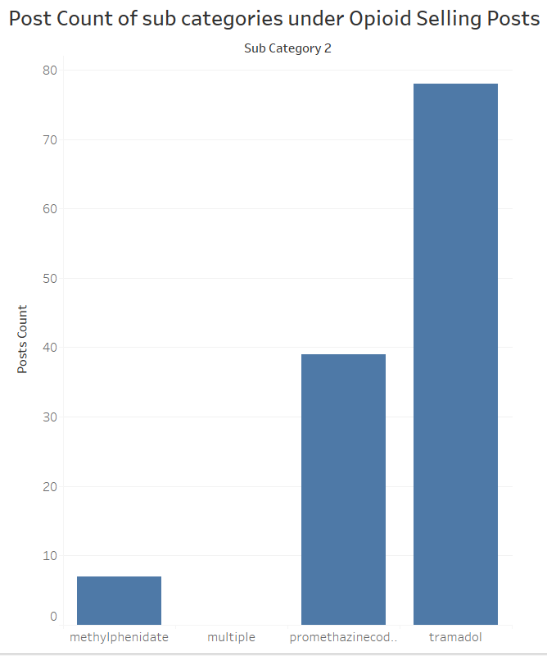
ANALYSIS OF OPIOID SELLING POSTS
21

Slide 22
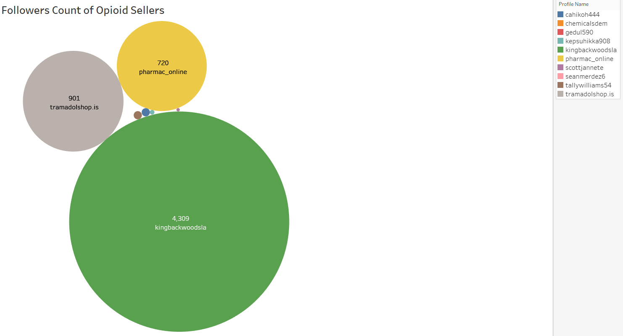
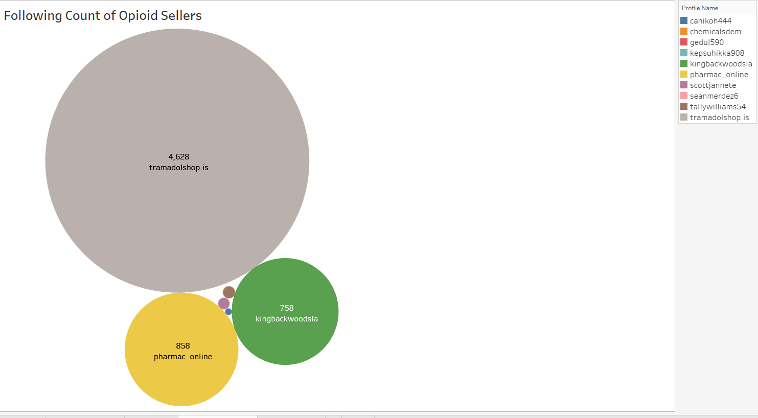
ANALYSIS OF OPIOID SELLER PROFILES
22
Notes:
References:
https://phantombuster.com/

Slide 23
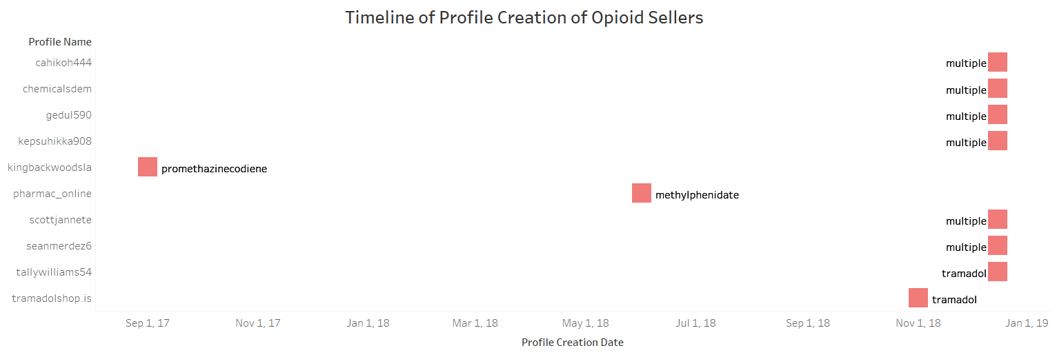

ANALYSIS OF OPIOID SELLER PROFILES
Used website: https://123accs.com/instagram-account-age-checker/
23
Notes:
References:
https://123accs.com/instagram-account-age-checker/

Slide 24
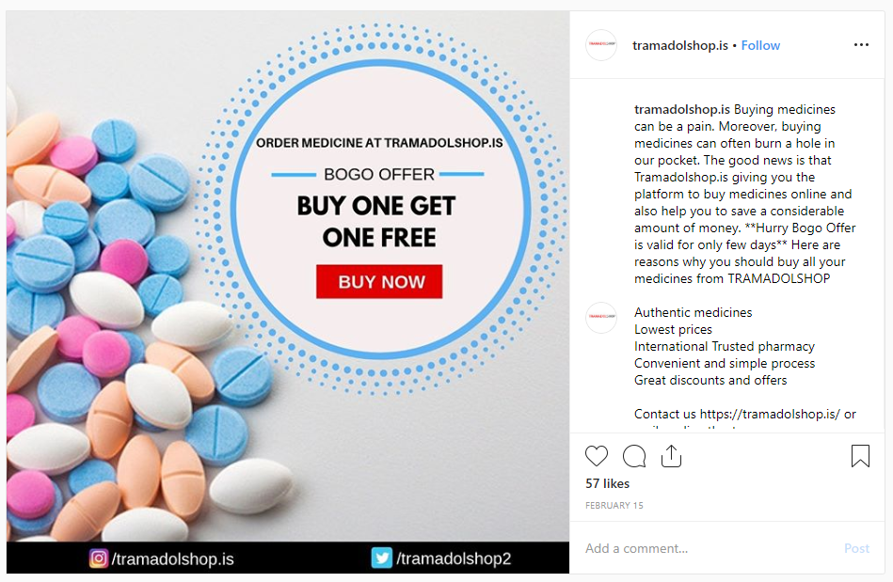
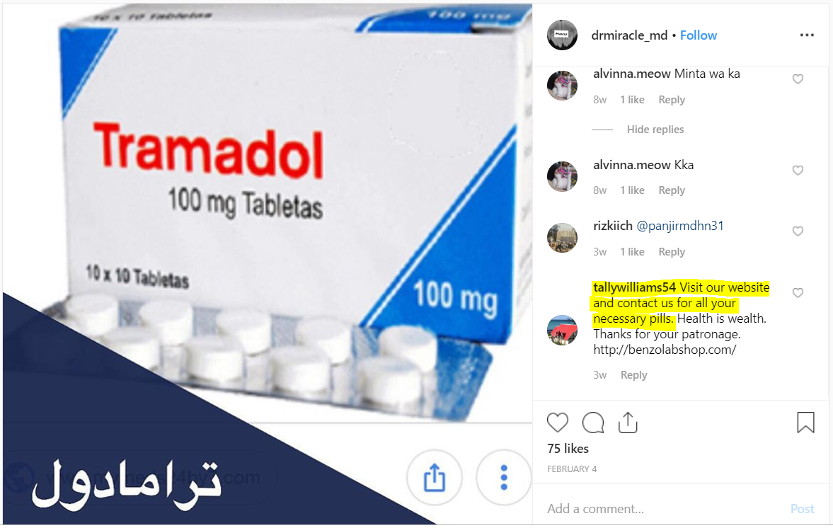
POSTS (OPIOID – TRAMADOL)

Slide 25
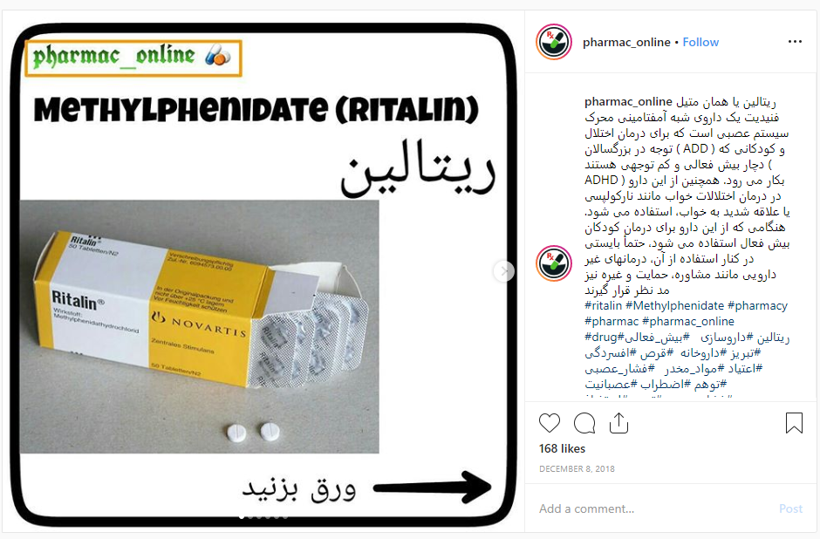
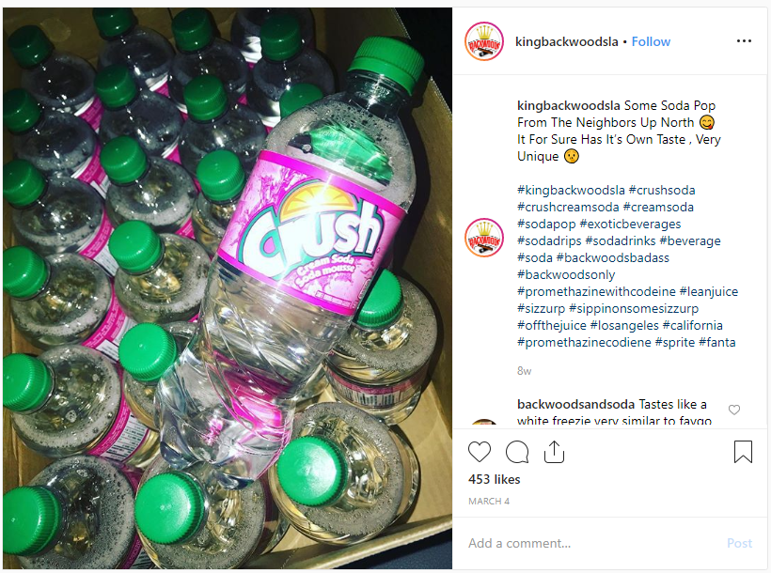
POSTS (OPIOID – METHYLPHENIDATE & PROMETHAZINECODIENE)

Slide 26
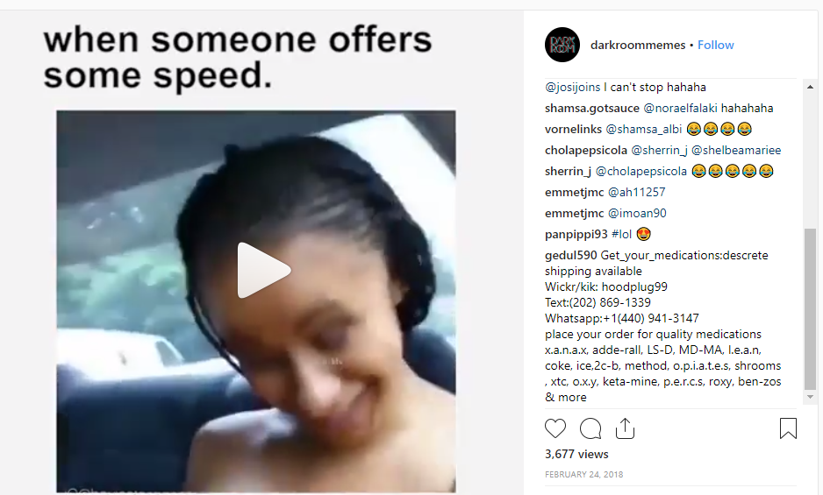
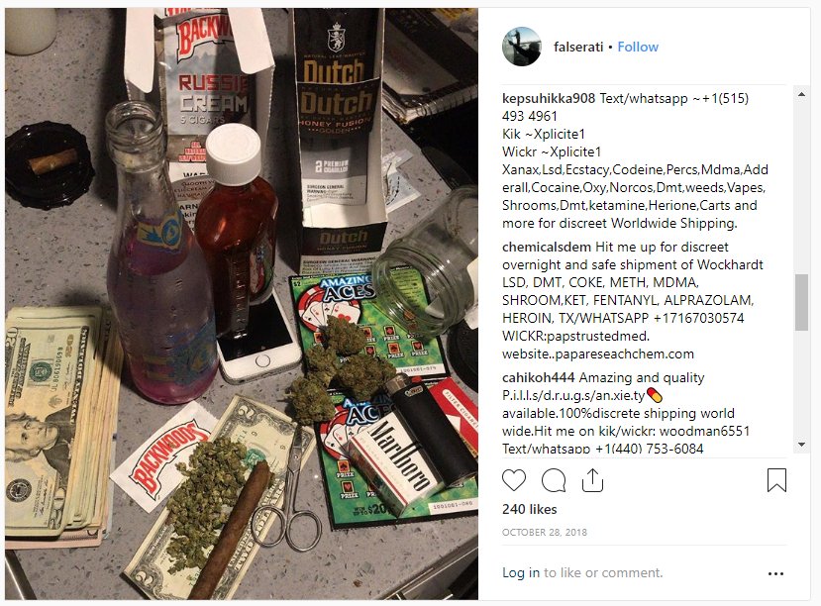
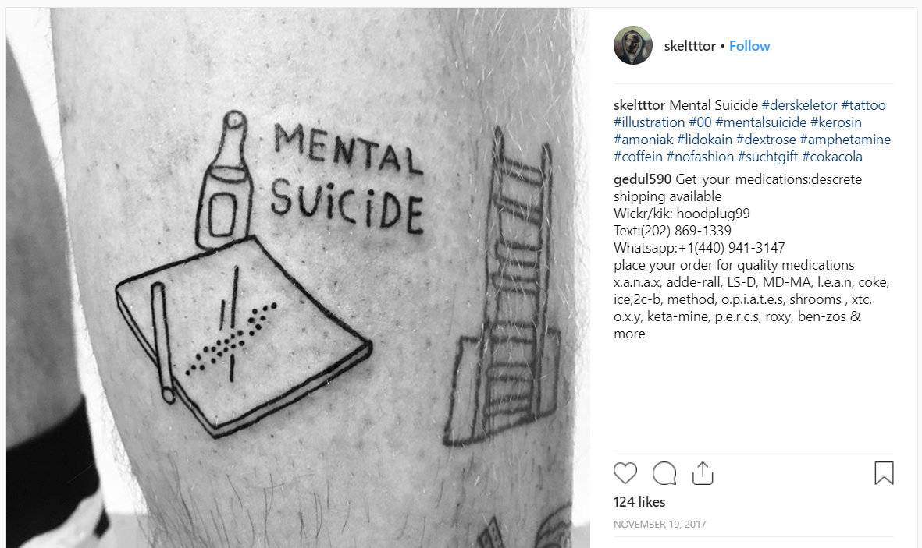
POSTS WHERE OPIOID SELLERS HAVE COMMENTED

Slide 27
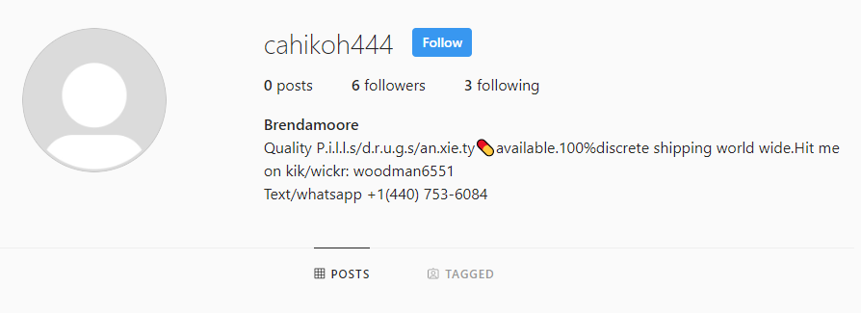
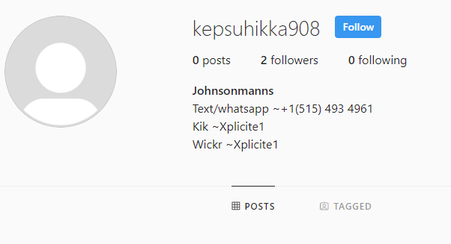
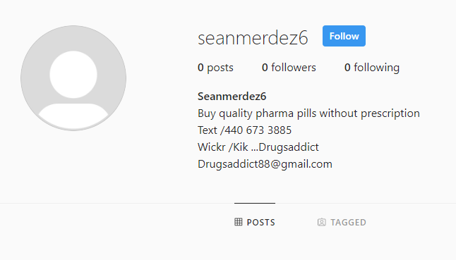
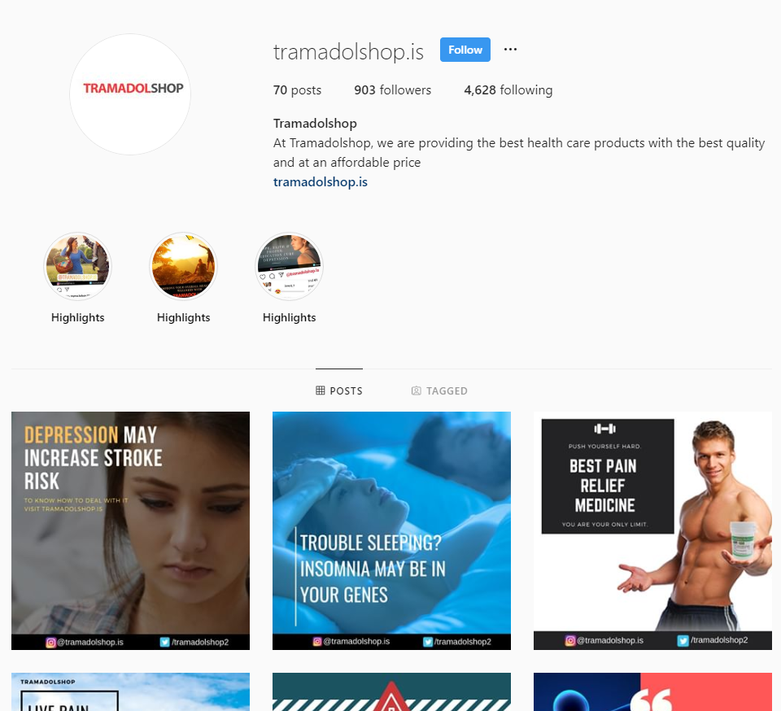
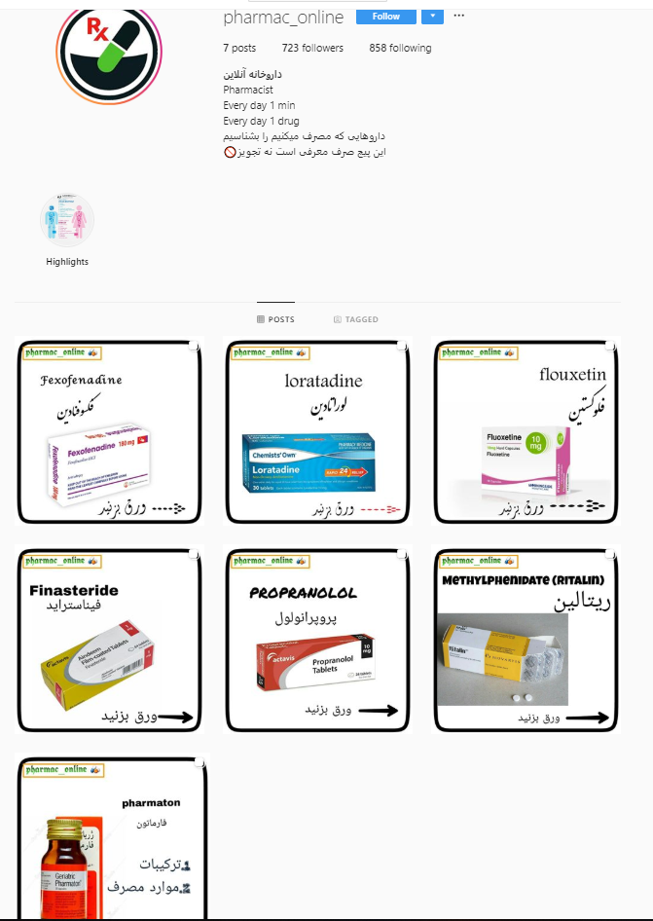
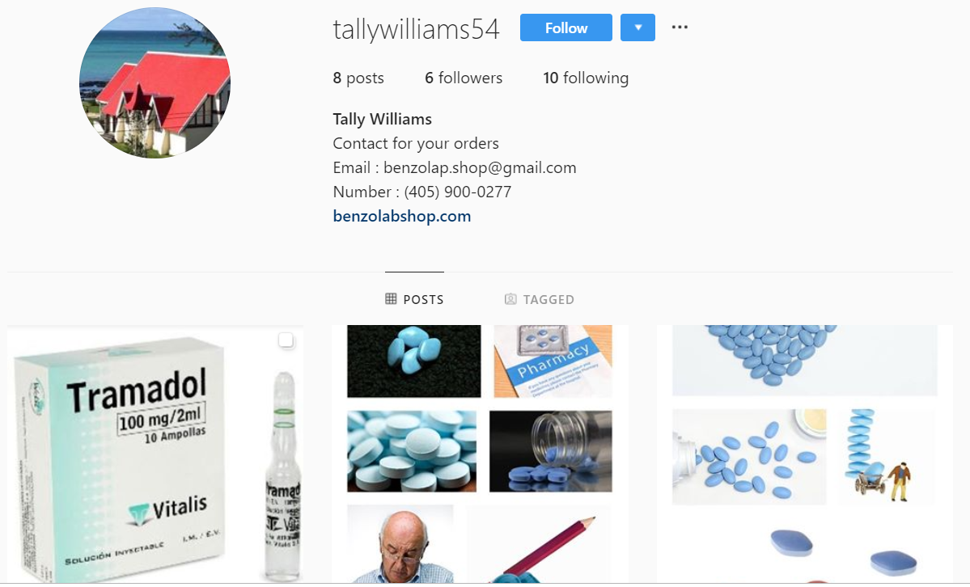
OPIOID SELLER PROFILES

Slide 28
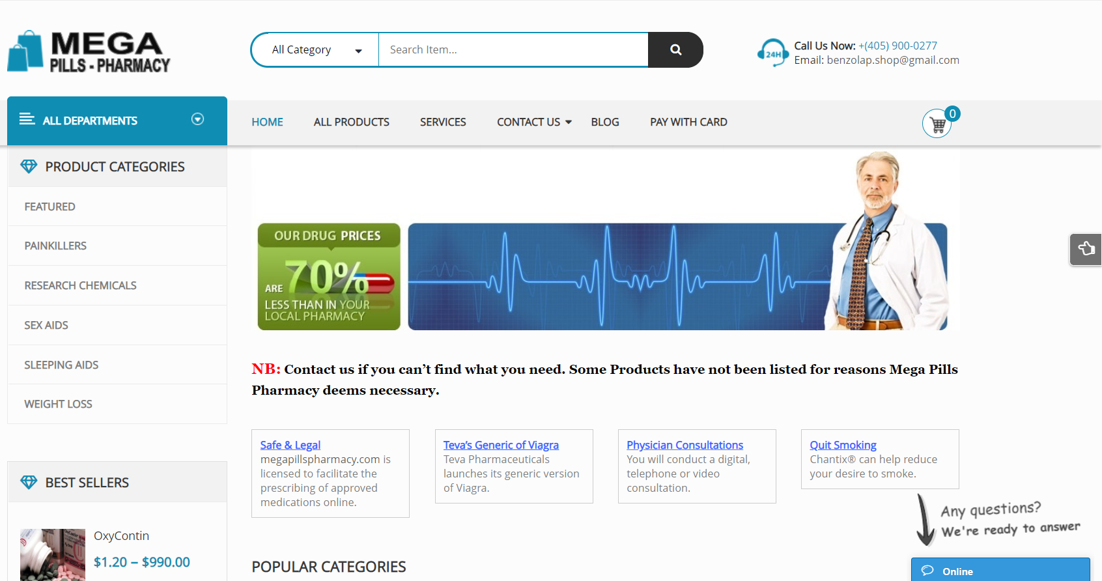
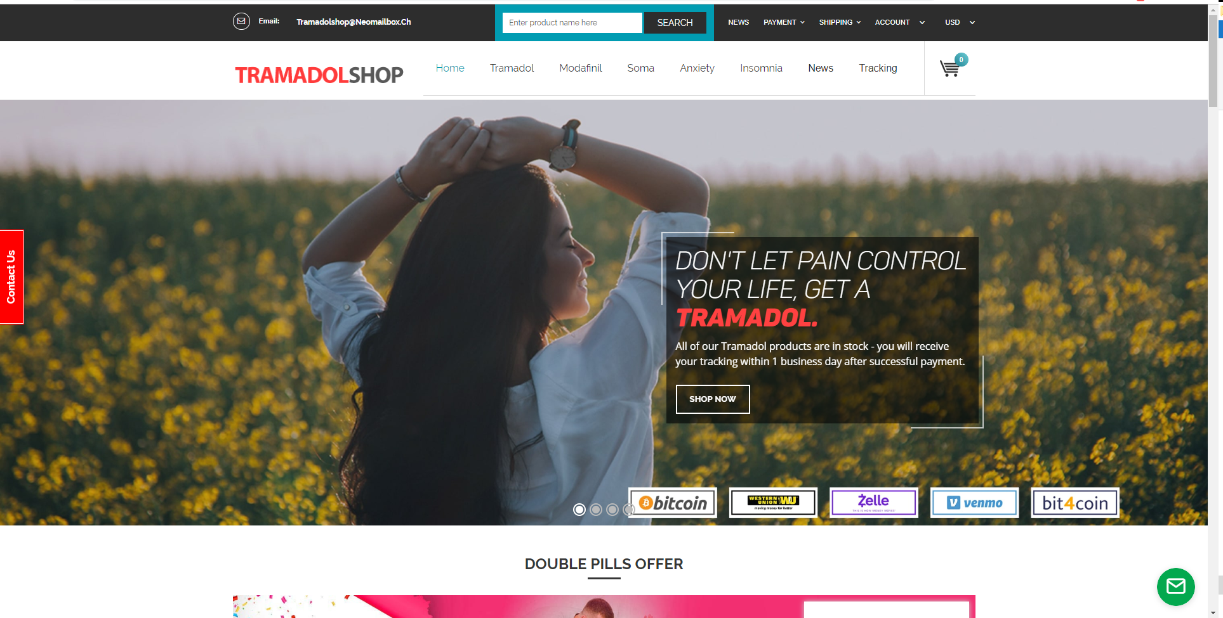
WEBSITES OF SELLERS

Slide 29
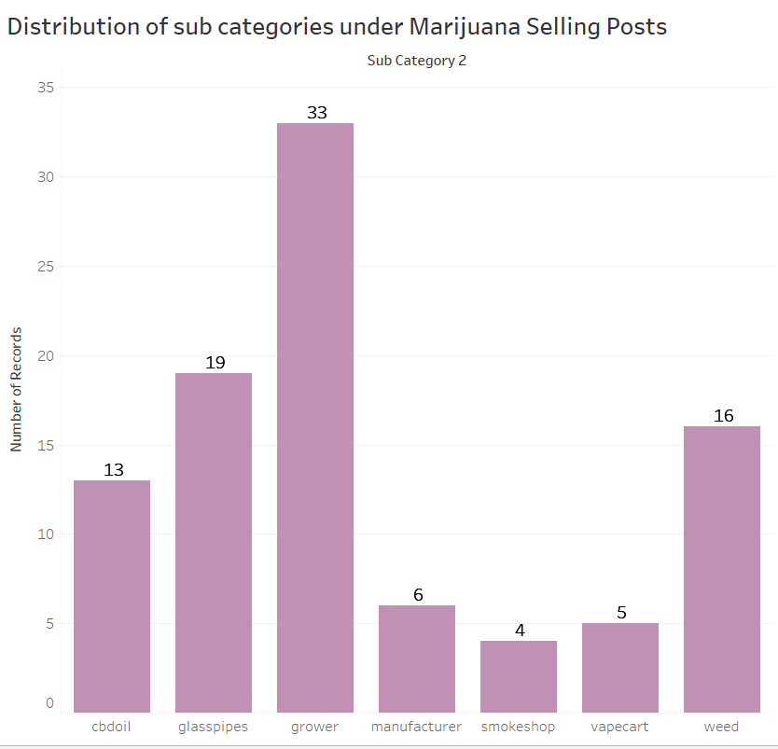
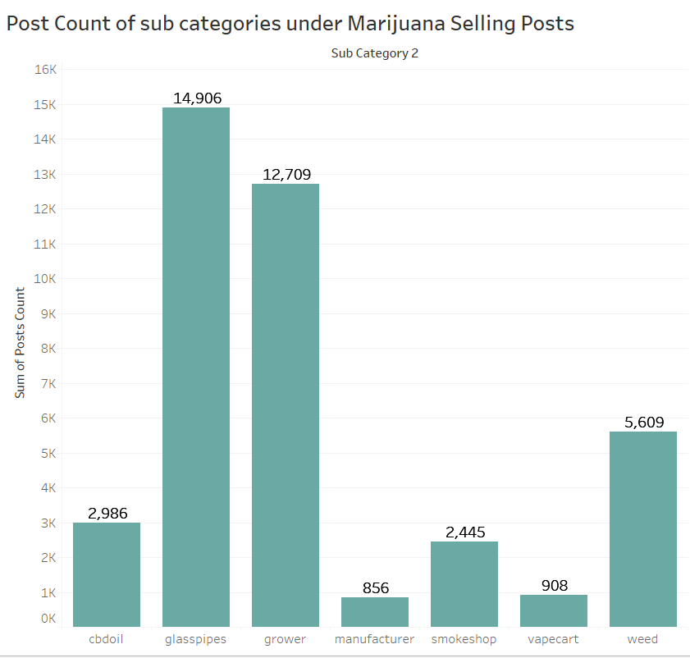
ANALYSIS OF MARIJUANA SELLING POSTS
29
Notes:
References:

Slide 30
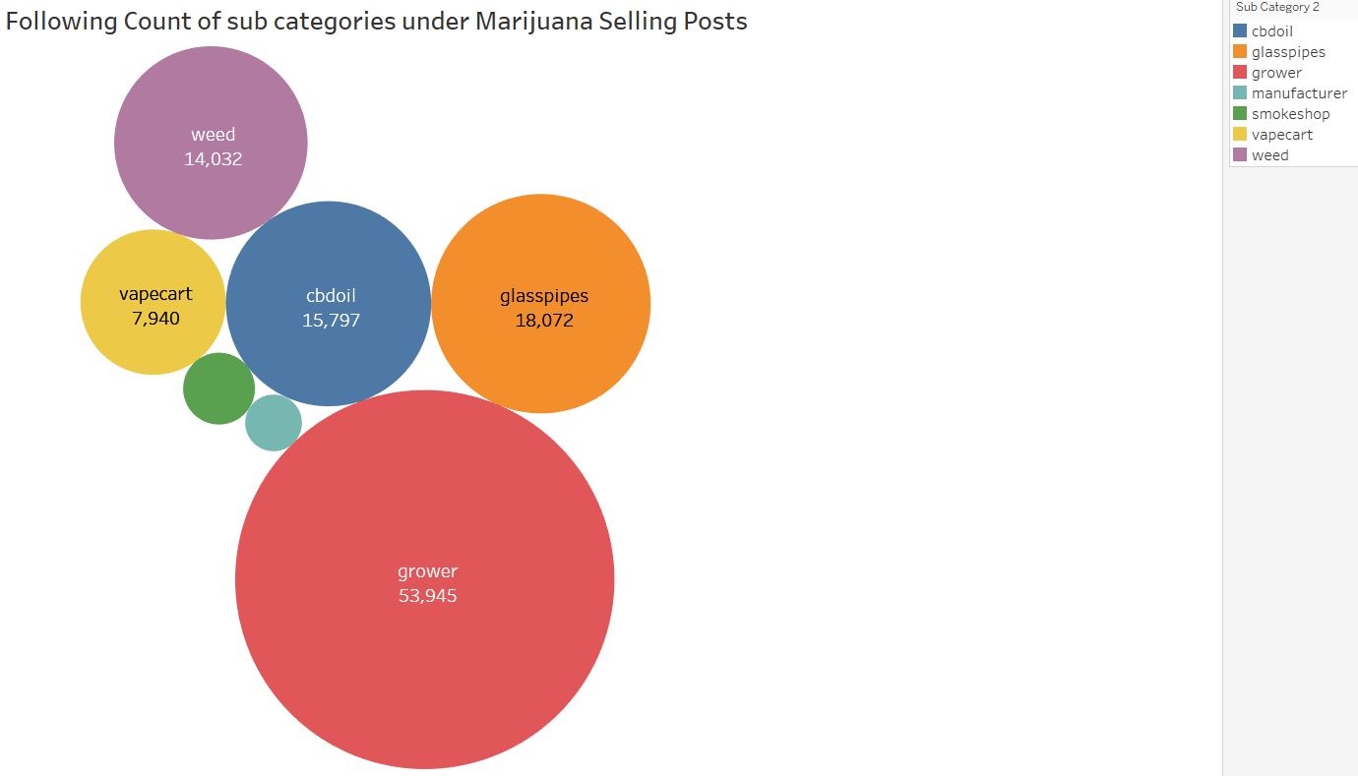
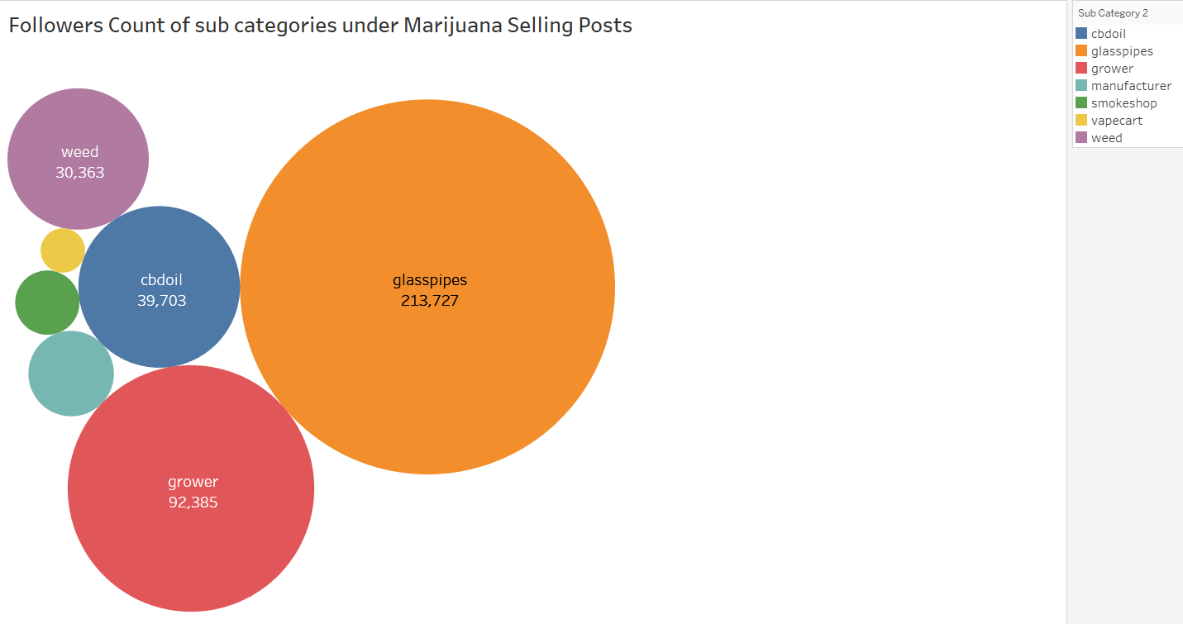
ANALYSIS OF MARIJUANA SELLING POSTS
30

Slide 31
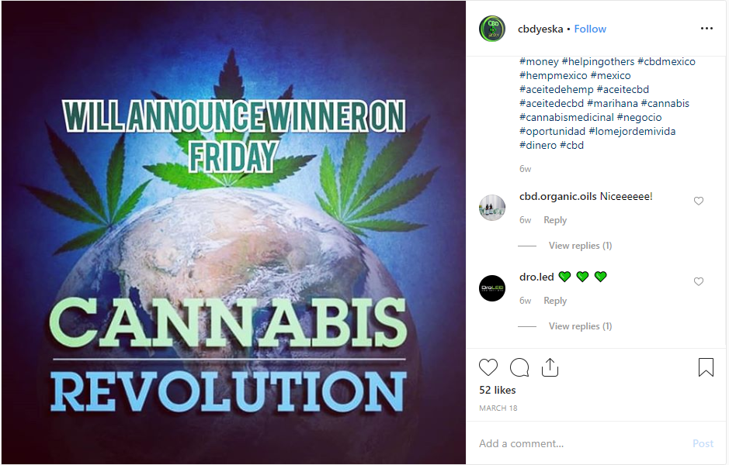
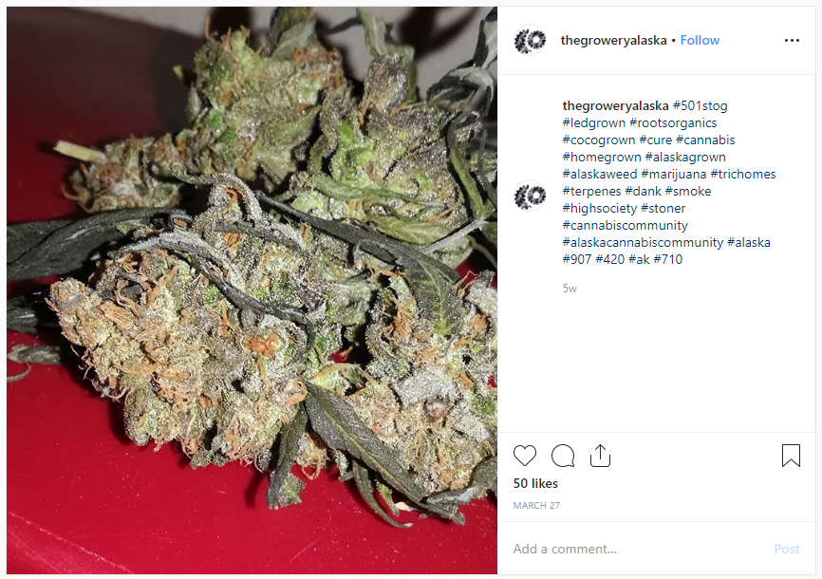
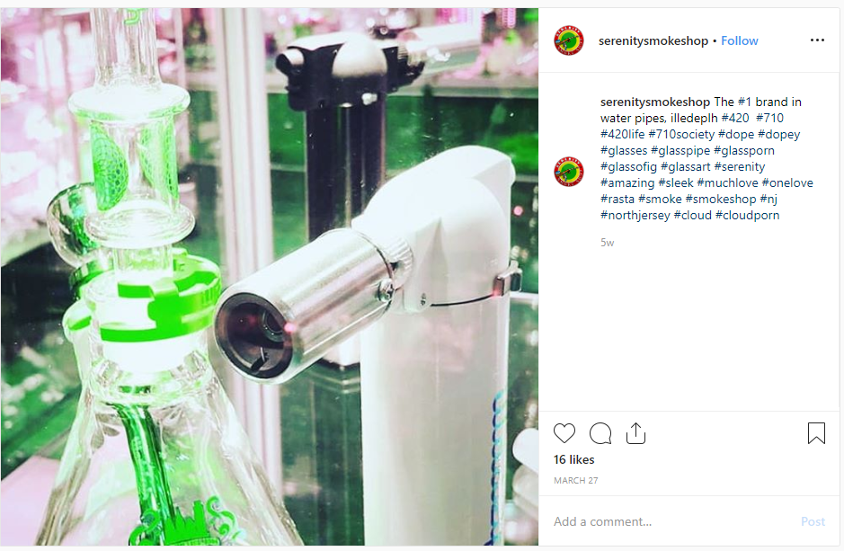
POSTS (CBDOIL, GLASSPIPE, GROWERS)

Slide 32
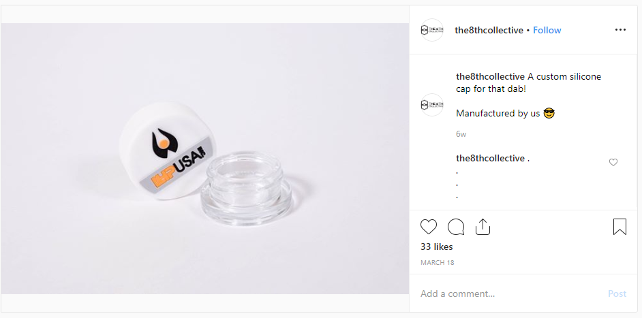
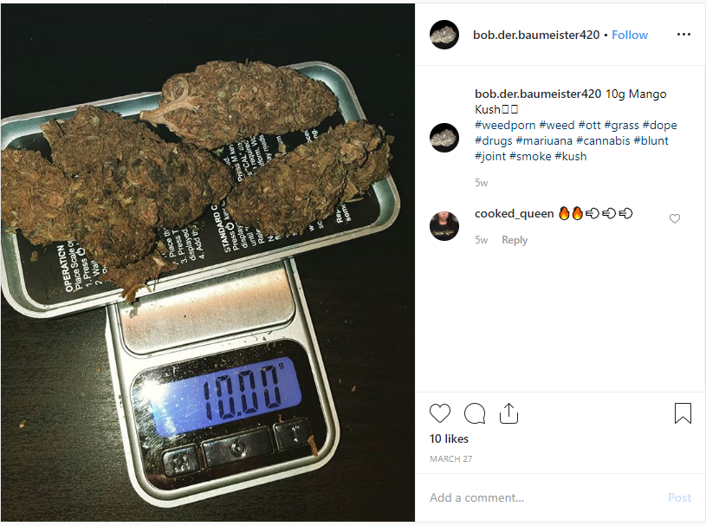
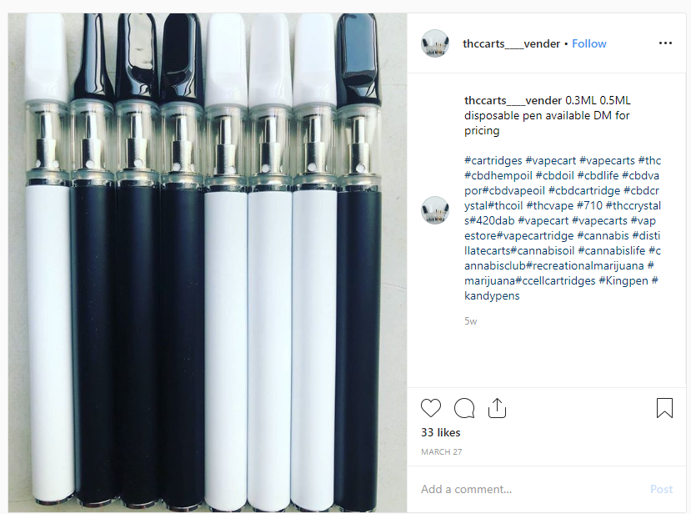
POSTS (MANUFACTURER, VAPECART, WEED)

Slide 33
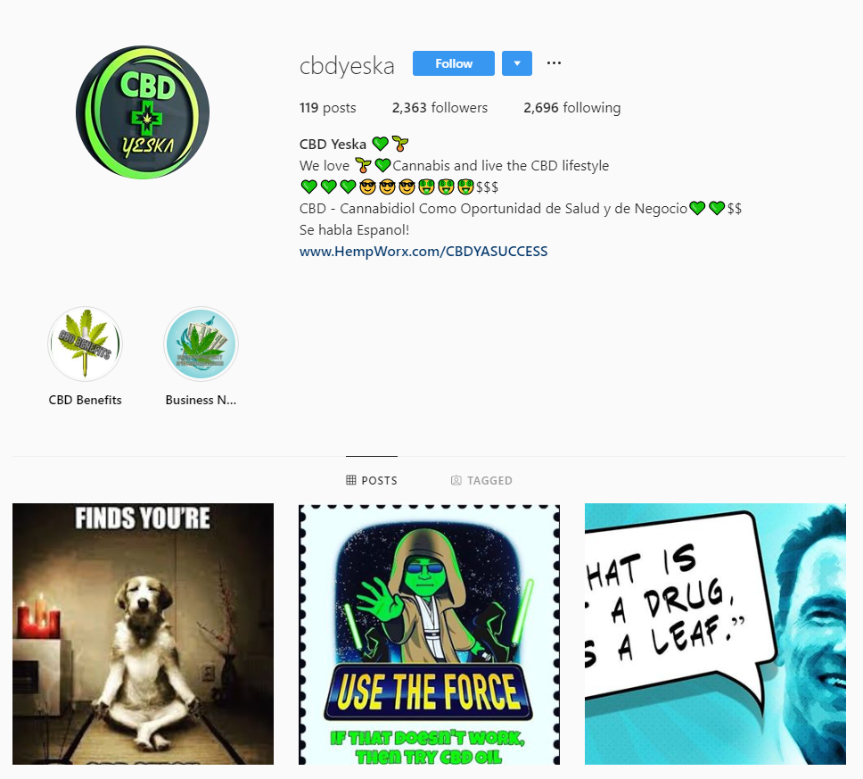
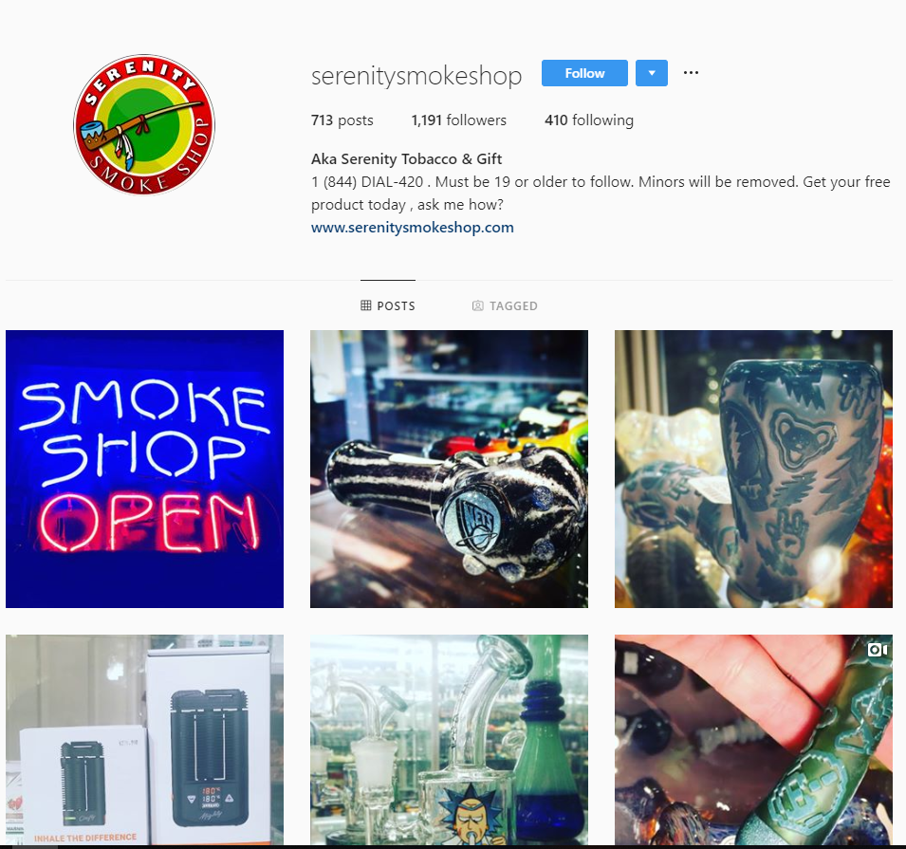
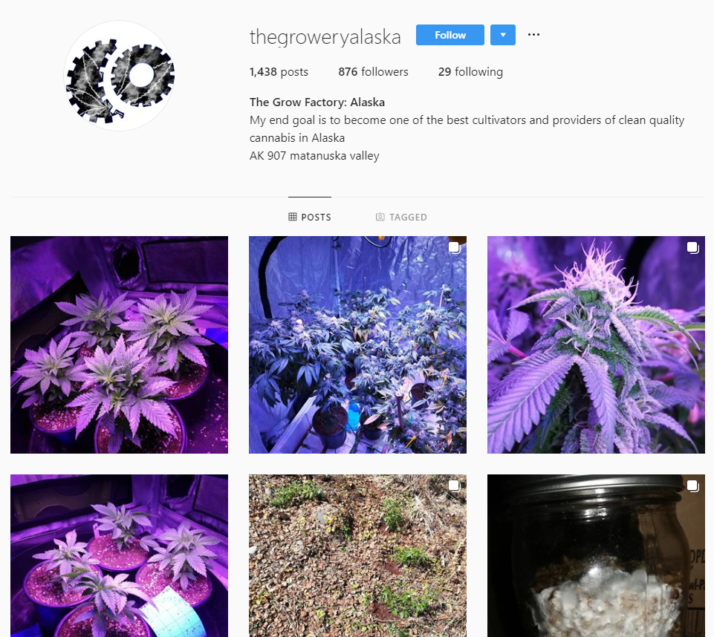
SELLER PROFILES (CBDOIL, GLASSPIPE, GROWERS)

Slide 34
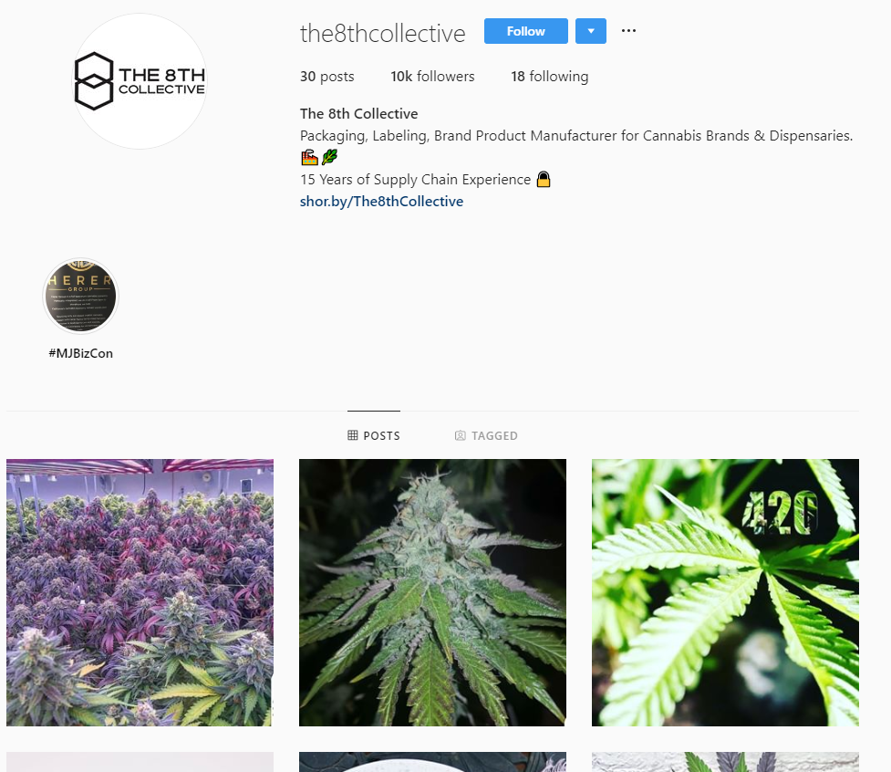
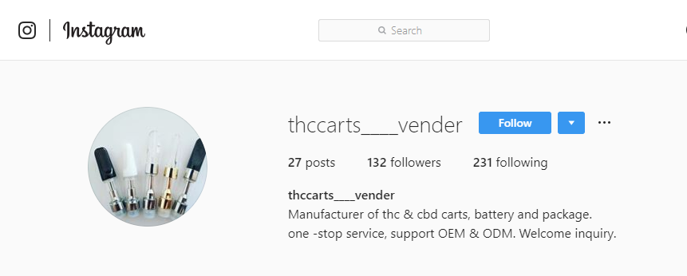

SELLER PROFILES (MANUFACTURER, VAPECART, WEED)

Slide 35



CONSUMER ANALYSIS
Experience Sharing
Consumers
News/Awareness
Selling

Slide 36


ANALYSIS OF OPIOID CONSUMER POSTS
36

Slide 37



POSTS (NARCOTIN & MARIJUANA)

Slide 38

EXPERIENCE SHARING ANALYSIS

Slide 39
EXPERIENCE SHARING POSTS (ADDICTION RECOVERY)

Slide 40
EXPERIENCE SHARING POSTS (OPIOID ADDICTION)

Slide 41
EXPERIENCE SHARING POSTS (MEDICATION EXPERIENCE)

Slide 42
EXPERIENCE SHARING POSTS (FAMILY ADDICTION EXPERIENCE)

Slide 43
EXPERIENCE SHARING POSTS (WEED/CANNABIS EXPERIENCE)

Slide 44
EXPERIENCE SHARING POSTS (FAMILY ADDICTION EXPERIENCE)

Slide 45
FUTURE SCOPE
Insights:
Instagram can be considered as one of the legitimate sources to find illicit online marketing, sales, and consumption of controlled substances
Manually classify more posts to:
Create classification models for the subcategories
Train the classifiers and improve the accuracy of classifications
Extract image data of these posts and use Google Vision API to improve the classification
45

